Slide 1

How to…
Build a PLN
on Twitter.

Slide 2
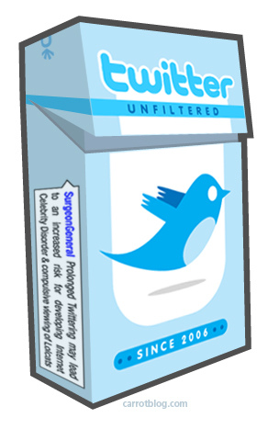
Twitter
Social Media
Limit of 140 Characters
Not just for celebrities
Protected/Unprotected
Notes:
What is twitter?
- A type of social media that is becoming more and more central to society – whether we like it or not! It allows people to publicly display any content they wish to share with others.
Limit of 140 characters which I think is fantastic as it allows you to quickly filter out the tweets you want to look at and disregard irrelevant information which may be a more challenging task within a blog/similar.
It is not just for celebrities - Companies, Charities, Schools and Teachers all use twitter to communicate.
You can choose to hide or show your tweets publicly or privately depending on content.

Slide 3
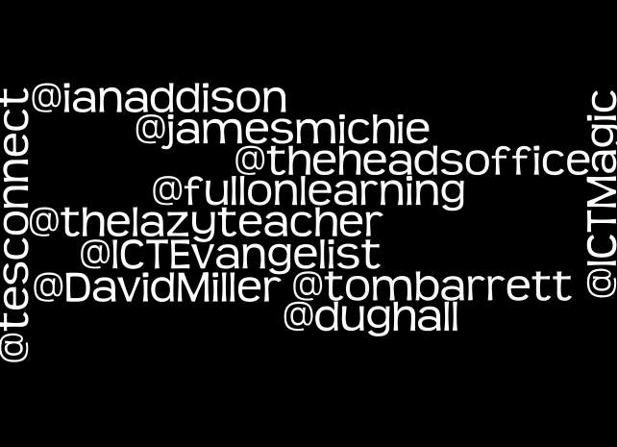
Notes:
Twitter for CPD
My main use of twitter is for learning and sharing ideas with other teachers and educators using a PLN (Personal/Professional learning network) which I have built up over the last year.
I you are just stating out I suggest you begin by following some other teachers - indeed the way I started to build my PLN was to follow people recommended to me by Mark Anderson (who I credit for this list on screen) and just observe what they a chatting about.

Slide 4
# Hashtags
#ff
#ukedchat
#edtech
Notes:
3 useful hashtags
Hashtags are used to catagorise and search for groups of tweets. Here are the three I use the most
#ff – Follow Friday which is great for getting good recommendations of who to follow.
#ukedchat – Chat between 8pm and 9pm on Thursday Evenings
#edtech – has information about various different types of education technology

Slide 5
Thanks for Listening…
Download the presentation from my blog; www.thomas-robinson.co.uk/teaching
Follow me! @mrtrobins
E-mail: trn@priorycofe.com
Notes:
Thankyou for listening.

